Slide 1
public class Classifier {
public static void main(String[] args) {
System.out.println(classify('n') + classify('+') + classify('2'));
}
static String classify(char ch) {
if ("0123456789".indexOf(ch) >= 0)
return "NUMERAL ";
if ("abcdefghijklmnopqrstuvwxyz".indexOf(ch) >= 0)
return "LETTER ";
/*
* (Operators not supported yet)
* if ("+-*/&|!=".indexOf(ch) >= 0)
* return "OPERATOR ";
*/
return "UNKNOWN ";
}
}
What does this program do?

Slide 2
public class Classifier {
public static void main(String[] args) {
System.out.println(classify('n') + classify('+') + classify('2'));
}
static String classify(char ch) {
if ("0123456789".indexOf(ch) >= 0)
return "NUMERAL ";
if ("abcdefghijklmnopqrstuvwxyz".indexOf(ch) >= 0)
return "LETTER ";
/*
* (Operators not supported yet)
* if ("+-*/&|!=".indexOf(ch) >= 0)
* return "OPERATOR ";
*/
return "UNKNOWN ";
}
}

Slide 3
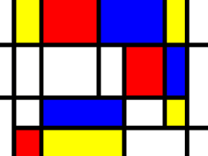
6-2 Balancing Abstraction
One of the things that make code complicated to read and understand is when the instructions inside a method are at different levels of abstraction.
So as to make the least work in changing things,
and the most code clarity.
Notes:
Image from https://www.javacodegeeks.com/2015/03/balanced-abstraction-principle.html

Slide 4
Outline
Exam 2 format
What is abstraction?
Balancing abstraction
Control and data abstraction
Live coding – balancing control and data abstraction

Slide 5
Exam 2 format
Same as last time
Comprehensive
Room assignments:
Section 3: Olin 167
Section 4: Olin 169
New stuff:
Open/closed principle (Decorator)
Dependency inversion principle (Factory)
Reflection/Guice
Singleton
Command
Balanced abstraction (today)
Two practice exams posted
Optional exam design studio on those practice exams next Tuesday in class

Slide 6
What is Abstraction – to us in Software?
Abstraction refers to the act of considering a less detailed, but safe, definition of the observed program behaviors
The essence of abstractions is preserving information that is relevant in a given context, and forgetting information that is irrelevant in that context.
– John V. Guttag

Slide 7
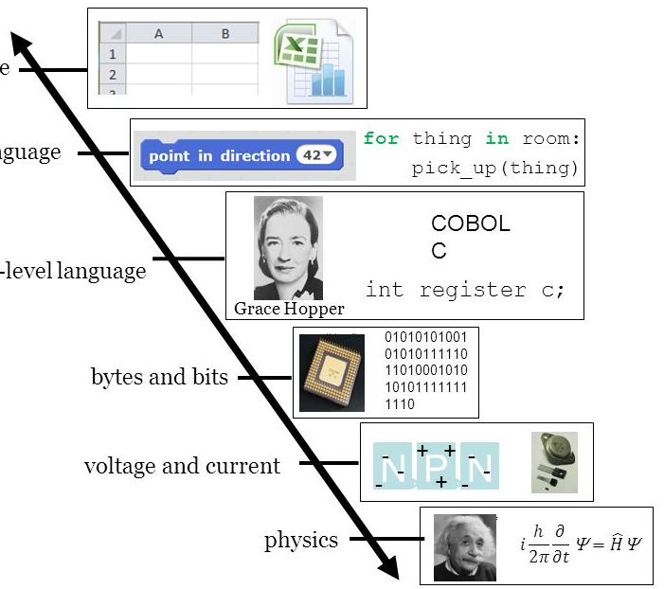
Abstraction is a Key Element of Computational Reasoning
Software Apps
Higher-Level Language
Lower-Level Language
Bits and Bytes
Voltage and Current
Physics
Notes:
Abstraction has served computing well from the very beginning…
We don‘t talk about our programs in terms of circuitry.
Rather, we build user-facing software in a high level language, like Java.
Java in turn implements certain low-level operations in C.
C code calls kernel code.
Kernel code invokes raw assembly.
And so forth.
But imagine trying to build Excel on a bread board – insanity!

Slide 8
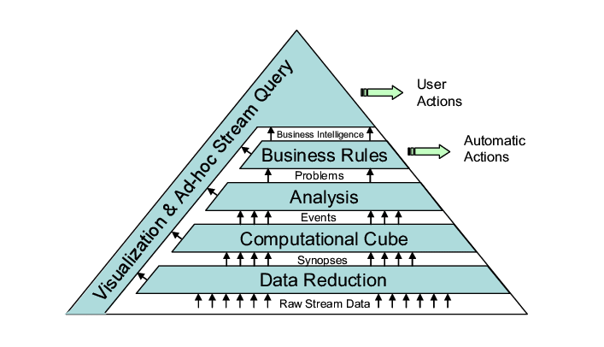
Typically, there are “levels” of abstraction
This is CHAOS: A Data Stream Analysis Architecture for Enterprise Applications.
In it, “Business Rules” are high level.
You would not expect to see one buried in the “Data Reduction” layer of this design.
Notes:
In Big Data, there is too much data.
So we summarize it (synopsis)
And put it in a database (“cube”)
And then query it.
We identify problems that need our attention.
Some problems can be taken care of automatically.
Others need human intervention.
Notice the business rules up here don’t interact with the raw stream of data down here.
All information flows only one way.
This is a good design because there is low coupling.
But more to the point, the design is dived into layers and each layer speaks the same language.

Slide 9
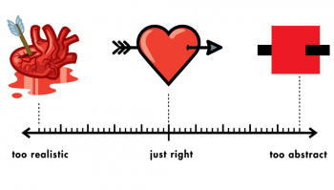
Balancing the Abstraction…
Too much Detail
About Right
Too little detail

Slide 10
What is Unbalanced Abstraction?
I need a Software Engineer
No, I will give you a Human
When an API object hides information that are expected of them in the client code, then we have an unbalanced abstraction.
Framework
Framework Client

Slide 11
Balanced abstraction – AWT Graphics
I need a Graphics object.
Here is a Graphics object!
CSSE220 Student
AWT paint method
Notes:
Ideal world: API returns exactly what is needed.

Slide 12
Unbalanced abstraction – in Swing
I actually need a Graphics2D.
Too bad! I only return Graphics.
// lies…
Graphics2D g2 = (Graphics2D) g;
CSSE220 Student
Swing’s paintComponent(Graphics g)
Notes:
When an API object hides information that is expected in the client code, then we have an unbalanced abstraction.

Slide 13
Symptoms of Unbalanced Abstraction
Violation of Dependency Inversion Principle
Tighter coupling between modules/classes
Violation of Open-Closed Principle
Use of Adapters [Covered Later]
Notes:
Violations of DIP – constructing the crazy concrete types and their dependencies that you don’t care about.
That results in coupling to the implementation details.
Open/closed: if the library is too abstract, have to keep modifying the library to expose more and more data.

Slide 14
Types of Abstraction
Control Abstraction
Functional decomposition of complex modules/class/methods into smaller units
Data Abstraction
A clear separation between the abstract properties of a data type and the concrete details of its implementation. E.g. List vs ArrayList and LinkedList

Slide 15
Violation of control abstraction
ClassNode classNode = new ClassNode();
// FIXME: its seems like we copy/paste this code everywhere
classNode.name = classReader.readName();
classNode.superName = classReader.readSuperName();
classNode.fields = classReader.readFields();
classNode.methods = classReader.readMethods();
Notes:
From last year’s Exam 1.
Information was forgotten.

Slide 16
A better way
ClassNode classNode = new ClassNode();
reader.accept(classNode);
Notes:
From last year’s Exam 1.
Information was forgotten.

Slide 17
Violation of data abstraction – too little data
private void mutateMap(ITile[][] mapRep) {
HashSet<ITile> tilesMarkedForMutation = selectTilesForMutation(mapRep);
for (ITile tile : tilesMarkedForMutation) {
// FIXME: I feel like instanceof is bad design?
// But I'm not sure how to set the yield otherwise.
// I don't think ITile should have a yield.
if (tile instanceof DiamondTile) {
((DiamondTile) tile).yield *= 2;
}
}
Notes:
From last year’s Exam 1.
Information was forgotten.

Slide 18
Violation of data abstraction – too much data
private void mutateMap(ITile[][] mapRep) {
if(isWindows()){
HashSet<WindowsDiamondTile> windowsTiles= selectWindowsDiamondTilesForMutation(mapRep);
for (WindowsDiamondTile tile : windowsTiles) {
tile.setYield(tile.getYield() * 2);
}
}
else if(isLinux()){
HashSet<LinuxDiamondTile> windowsTiles= selectLinuxDiamondTilesForMutation(mapRep);
…
Notes:
From last year’s Exam 1.
Information was forgotten.

Slide 19
Balanced data abstraction
private void mutateMap(ITile[][] mapRep) {
HashSet<DiamondTile> tilesMarkedForMutation = selectTilesForMutation(mapRep, DiamondTile.class);
for (DiamondTile tile : tilesMarkedForMutation) {
if (tile instanceof DiamondTile) {
tile.yield *= 2;
}
}
Notes:
From last year’s Exam 1.
Information was forgotten.

Slide 20
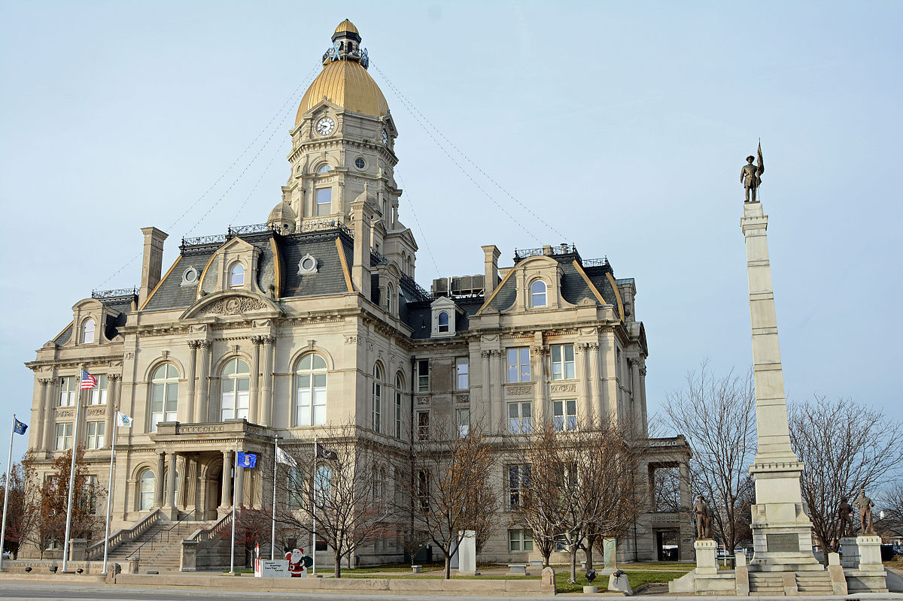
Landmark - Live Coding
A typical Terre Haute Landmark is featured!
Notes:
Image of Vigo County Courthouse from https://en.wikipedia.org/wiki/Vigo_County_Courthouse.

